Slide 1
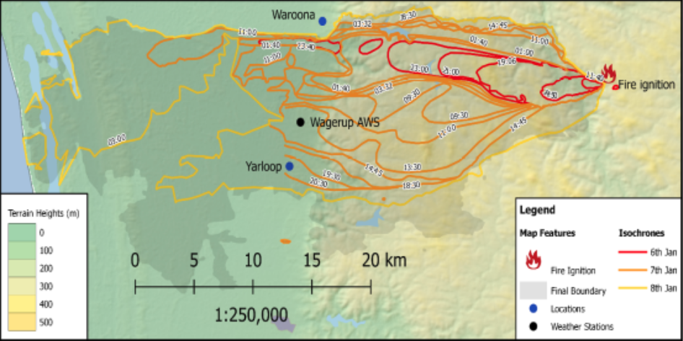
Waroona Fire
Emberstorms Downslope run PyroCB
Farmland and
rural towns
State forest and
mining areas
Escarpment (~300m)

Slide 2
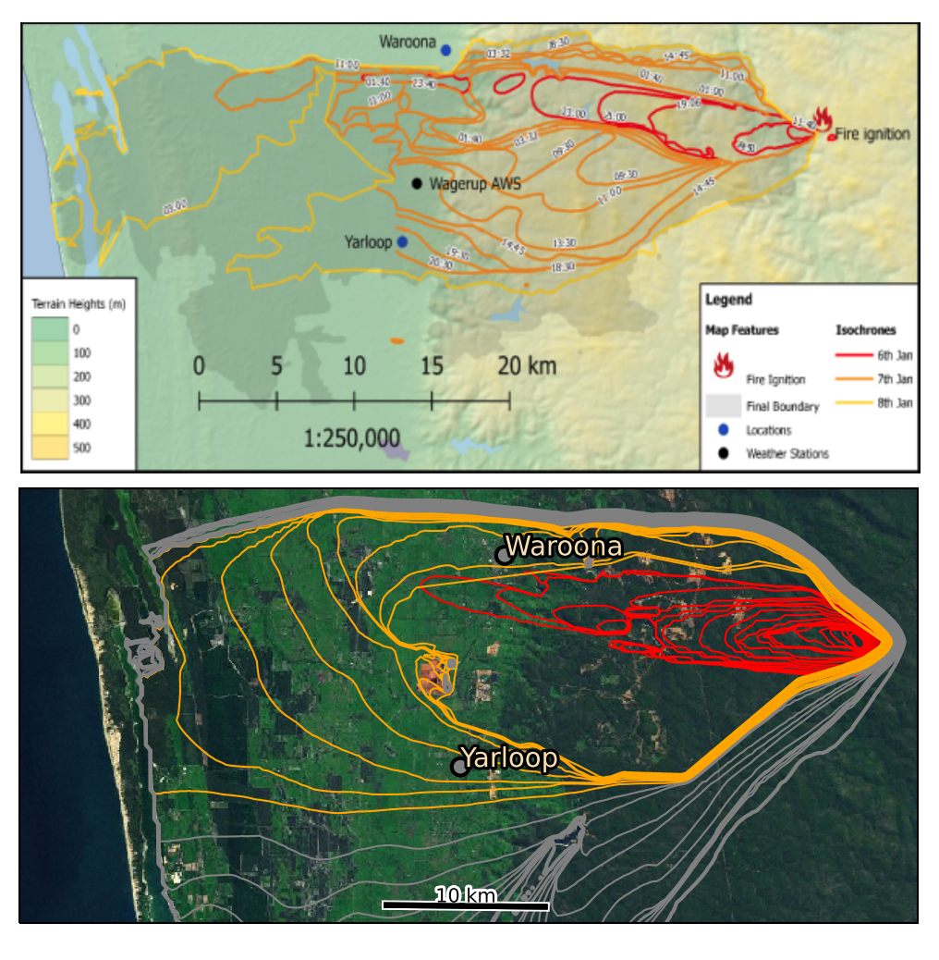
Simulated Fire
Initial polygon and spotting added by Harvey
Downslope run on first evening can be seen
Second day coverage not unreasonable.
Model does not include impacts from control attempts.

Slide 3
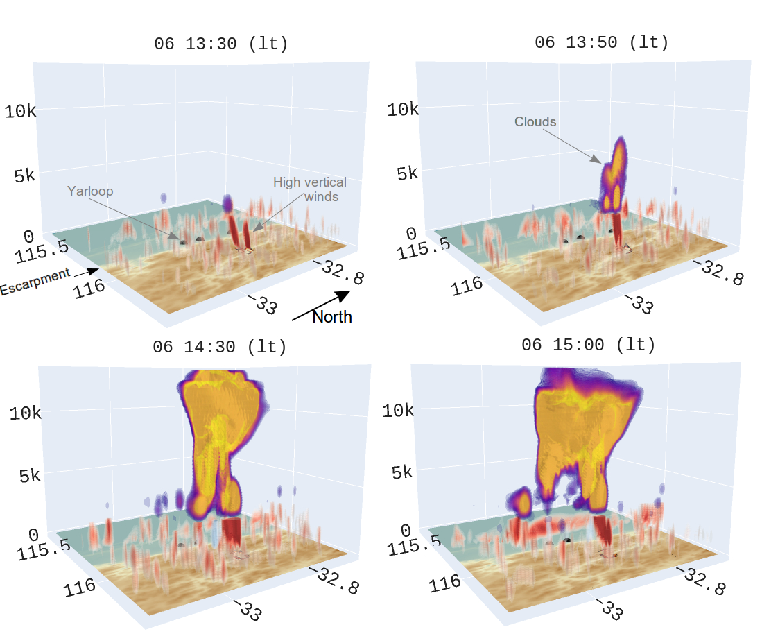
Pyrocumulonimbus (PyroCB)

Slide 4
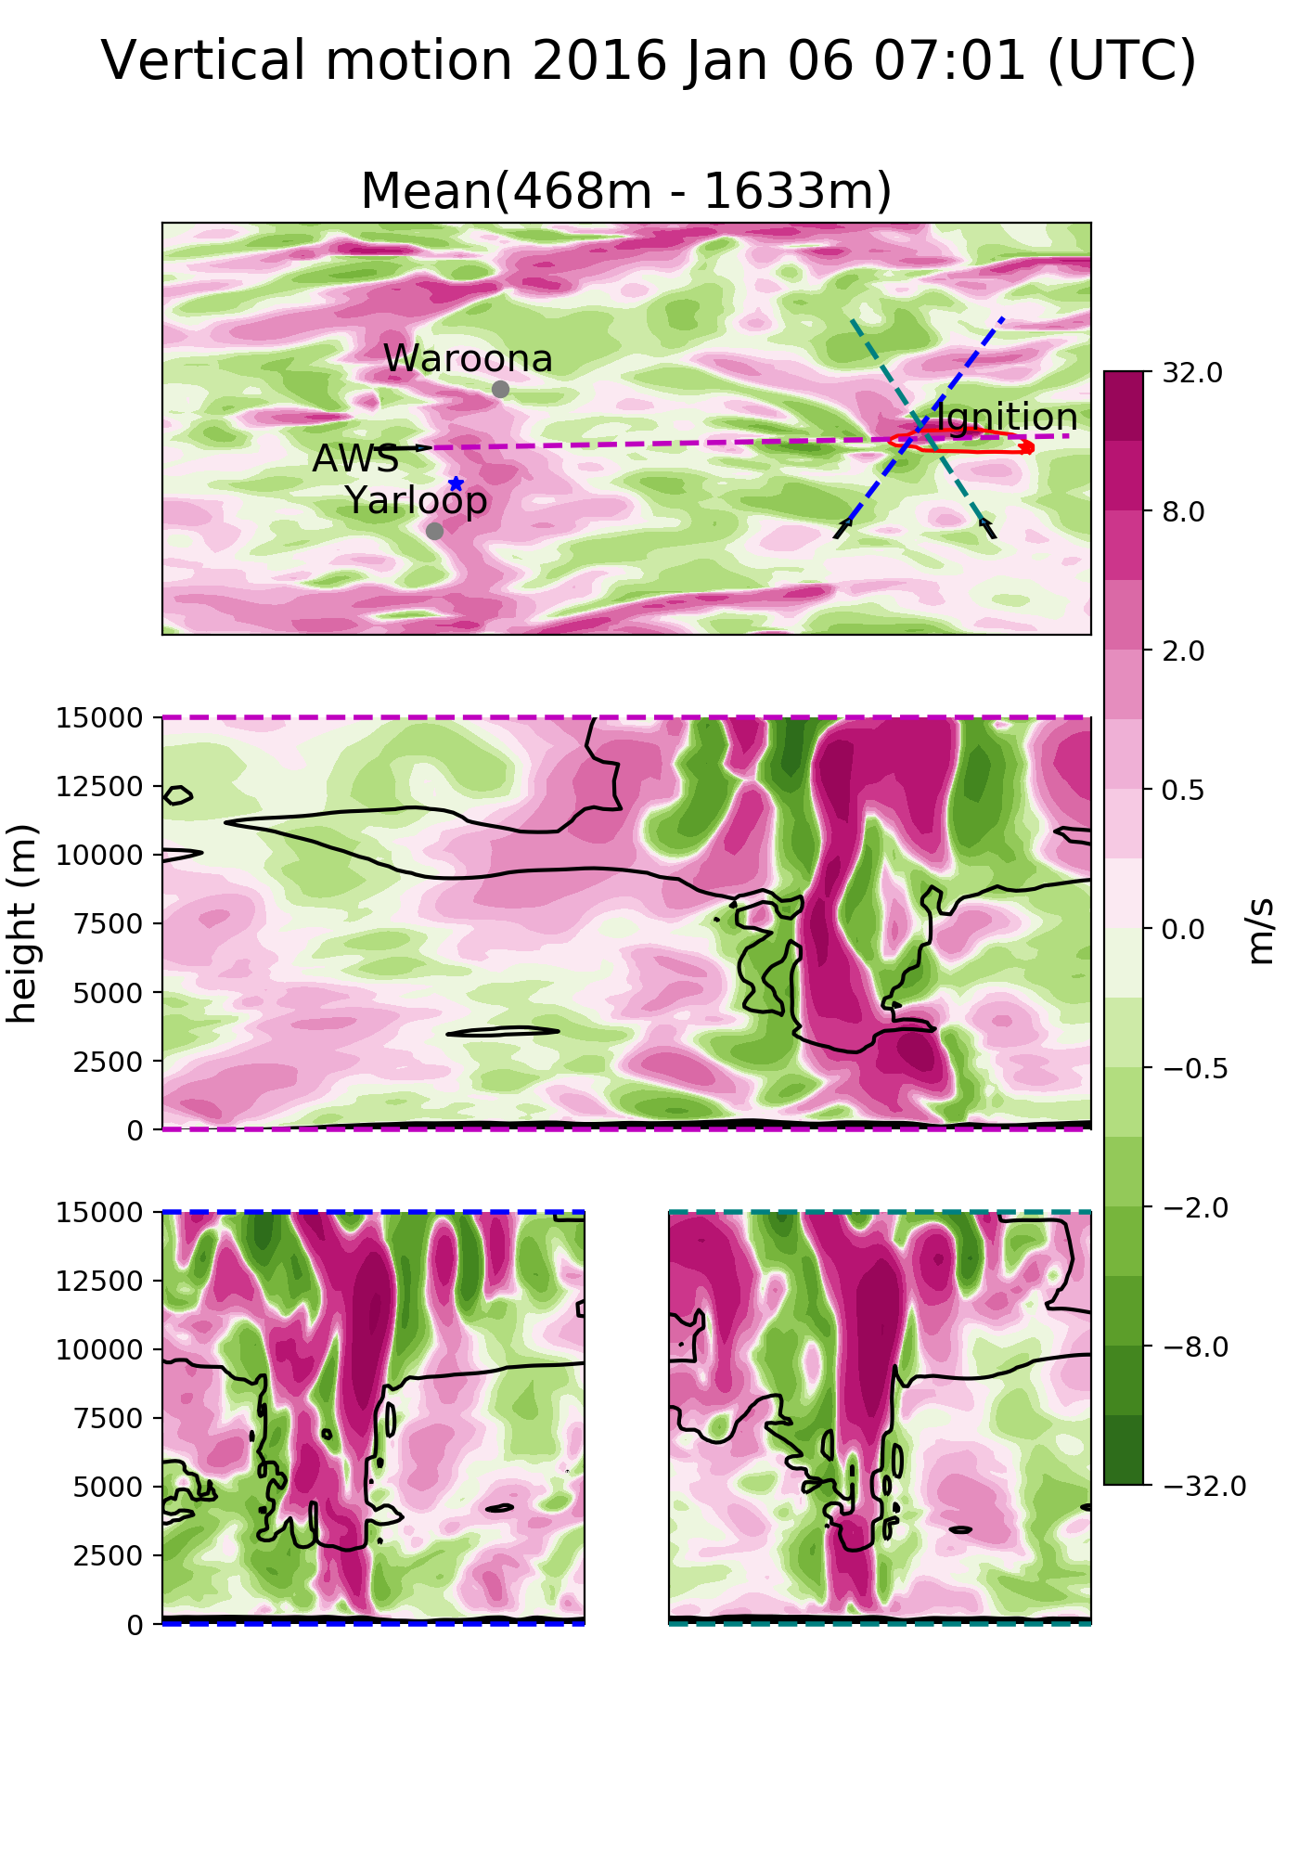
PyroCB Transect
Strong
Updrafts
Strong
downdrafts
Notes:
Update with your own Facebook and Twitter handles
1

Slide 5
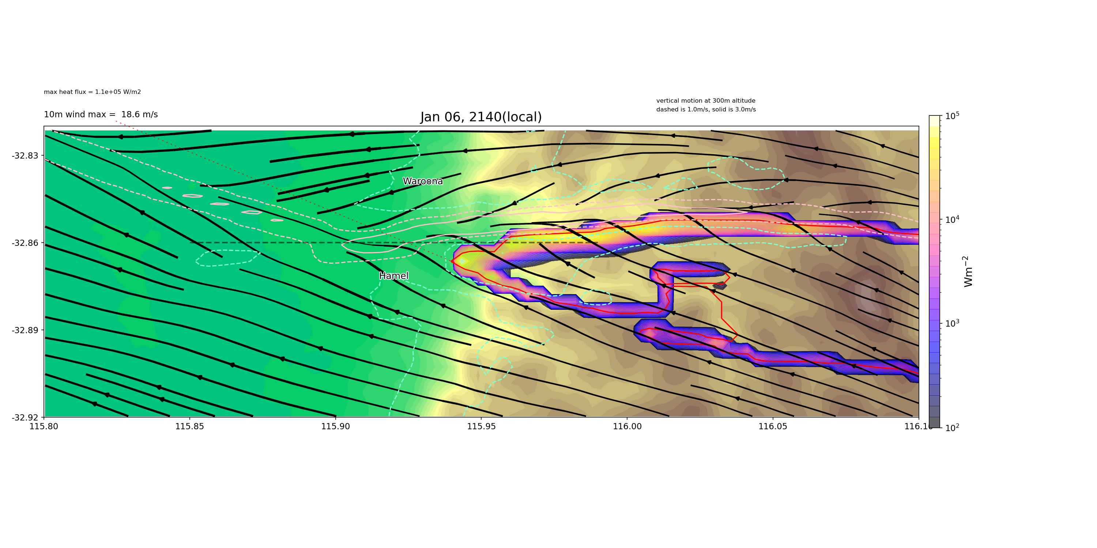
Emberstorm
Driven by high down slope winds with strong entrainment.
Will be discussed in more depth by Mika

Slide 6
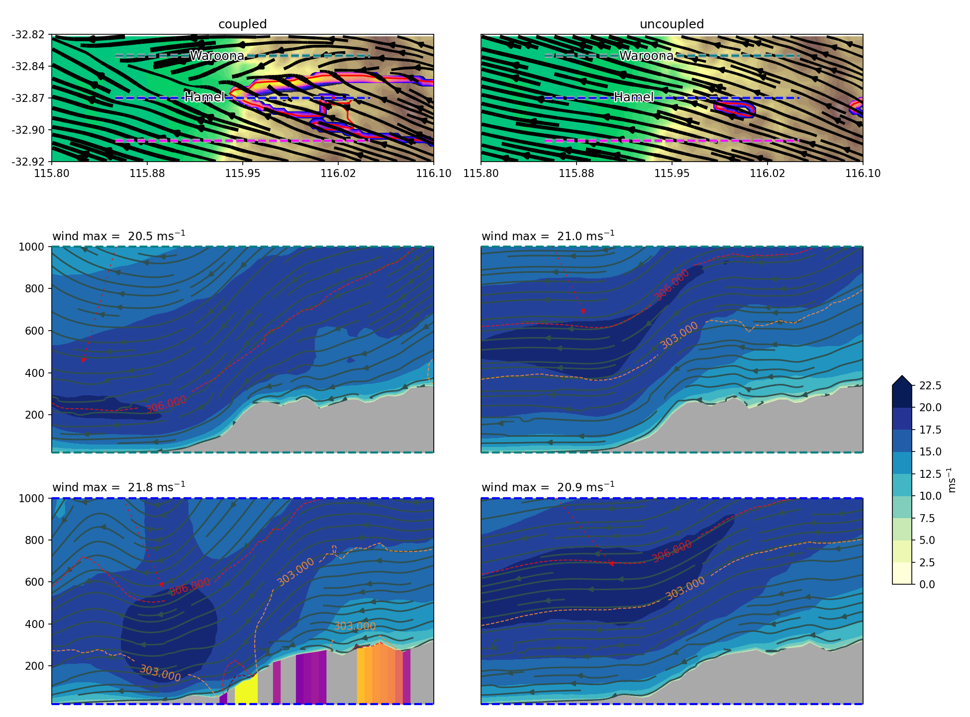
Coupled run Uncoupled run
Horizontal wind Transects

Slide 7
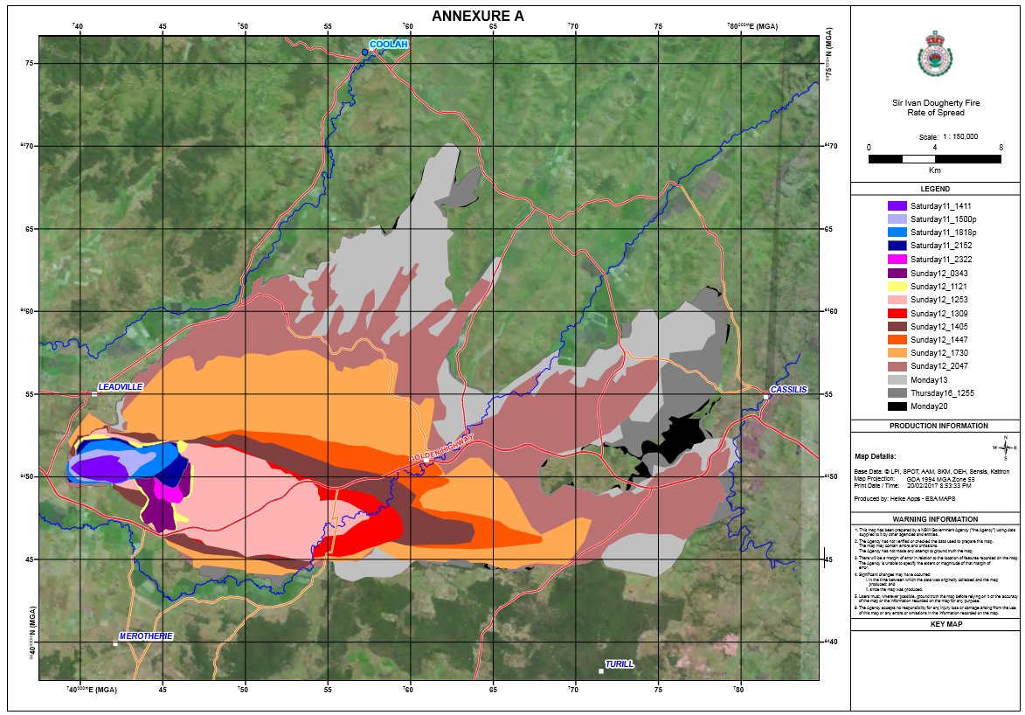
Sir Ivan Spread

Slide 8
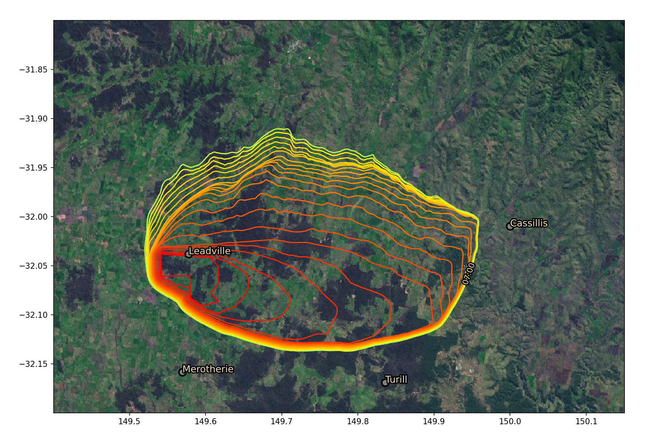
Sir Ivan Spread
Spread is reasonably well captured
Bottom left: hourly firefront contours
Bottom right: intensity
~ 40 km

Slide 9
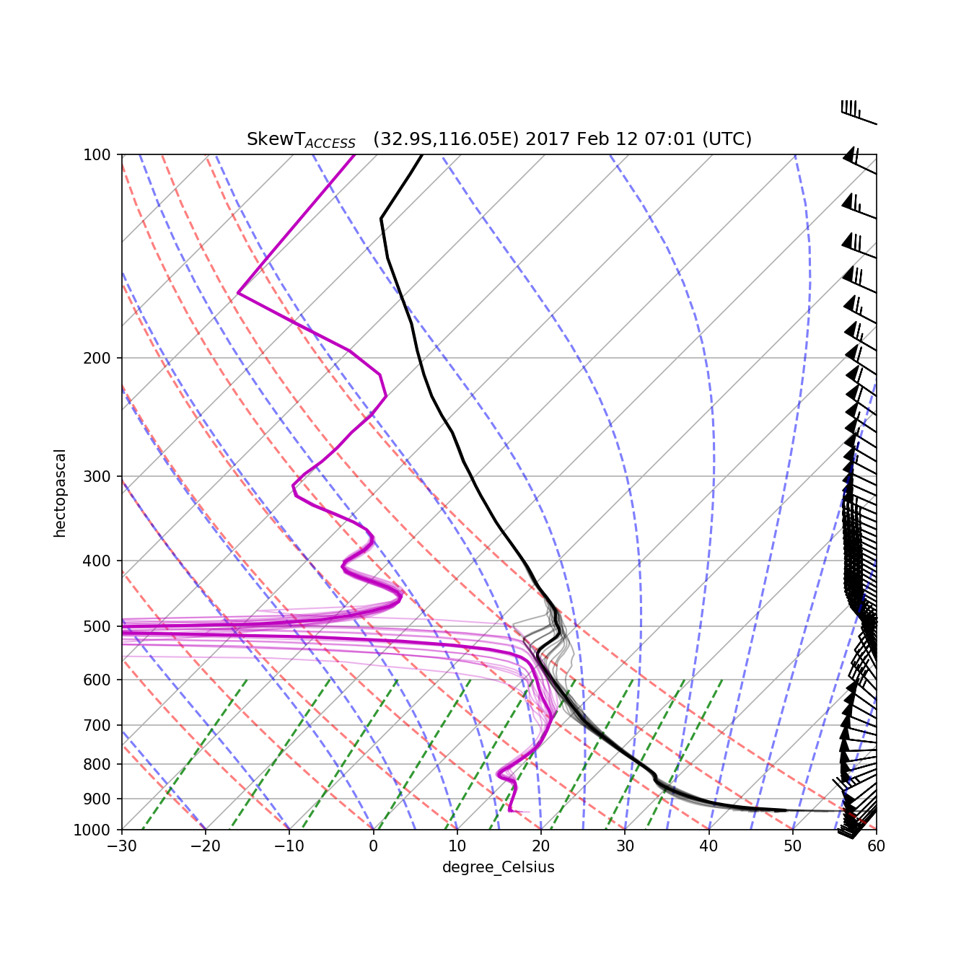
Kevin’s PFT
Theoretical energy requirement to form PyroCB
PFT = C (Z_{fc})² U b_{fc}
PFT: PyroCB Firepower Threshold
C : constant
Z_{fc} : free convection altitude
U : wind speed
b_{fc} : ML escape energy required

Slide 10
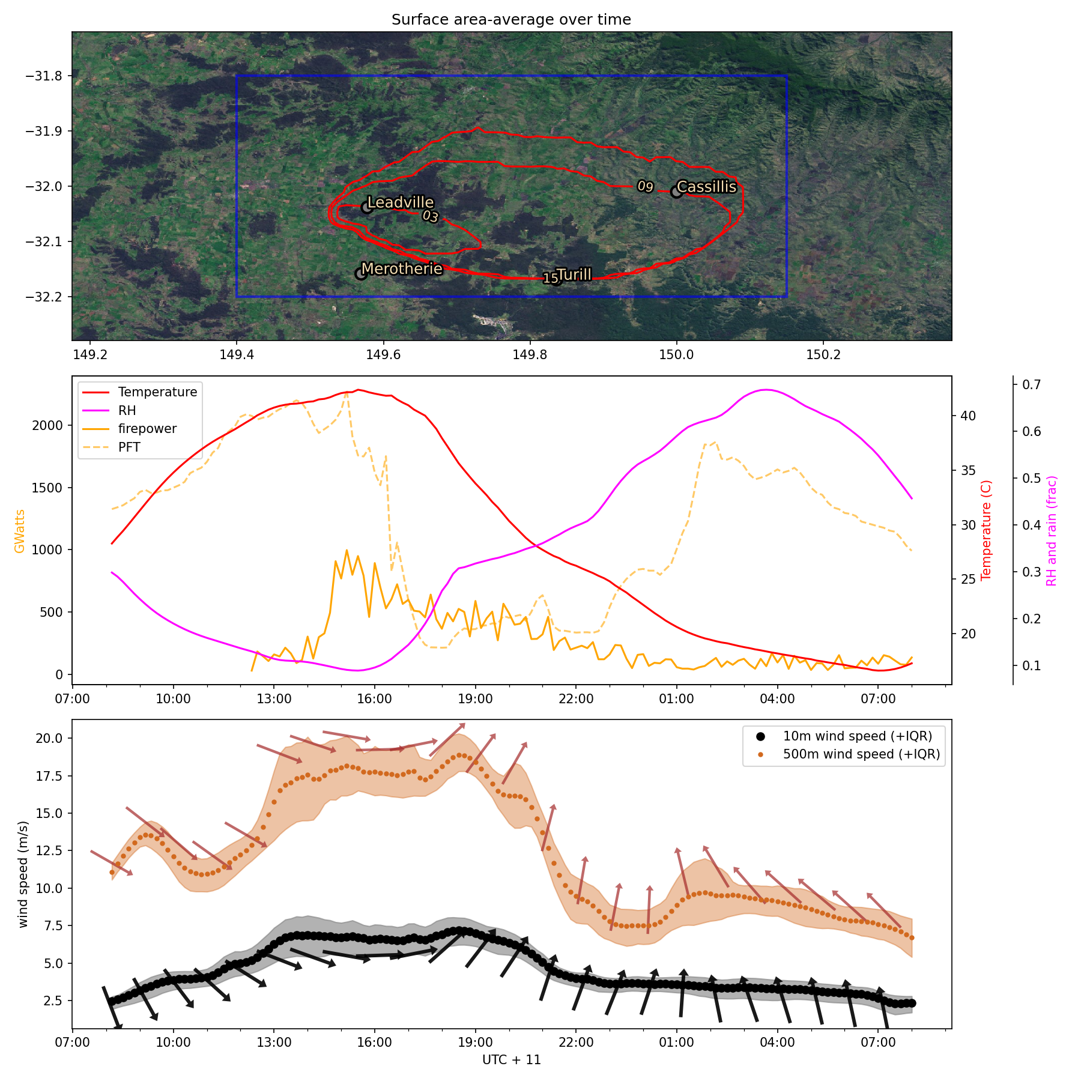
PFT compared against total model firepower
PFT calculated upstream of fire
Fire power
PyroCB window of opportunity
Model Pyrocumulous convections occurs around 6PM (local time)

Slide 11
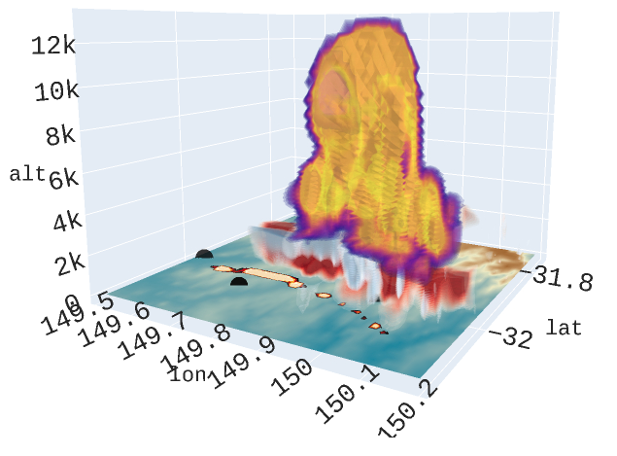
Modelled Pyrocumulous
Intense fire

